Slide 1

Toolkit Doc16 Shoulder Covers
May 5, 2010

Slide 2

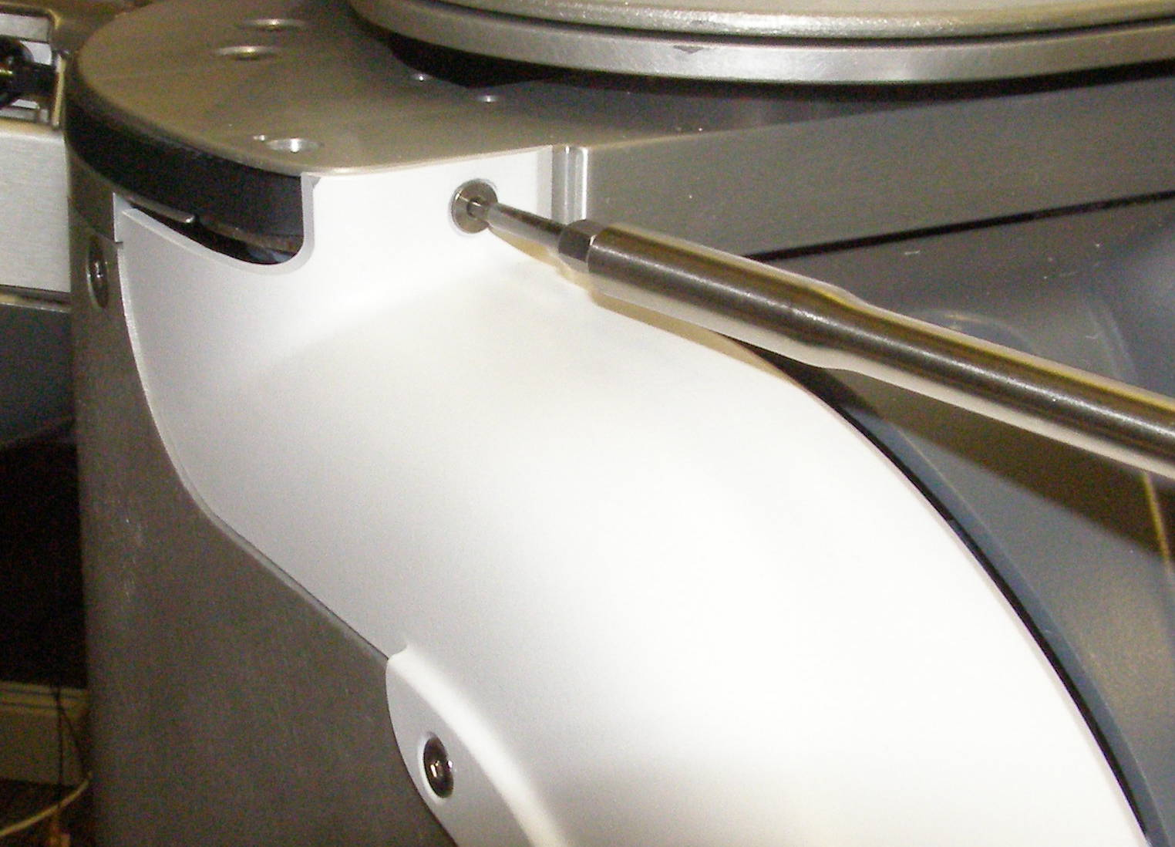
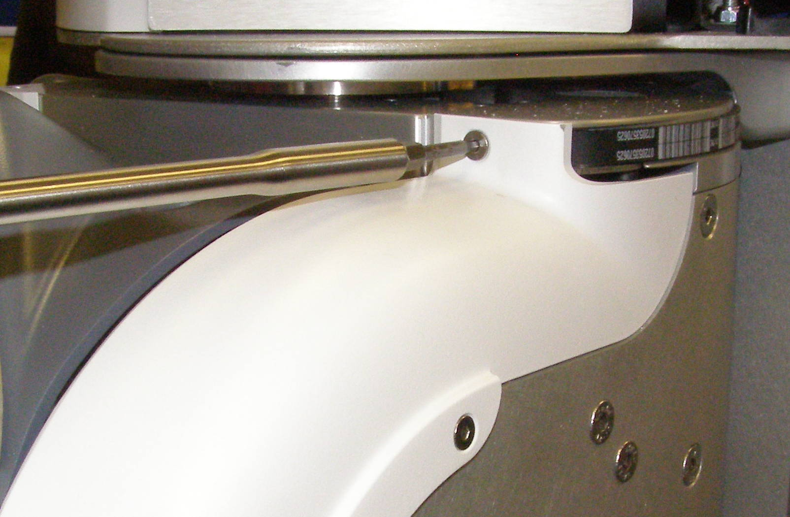
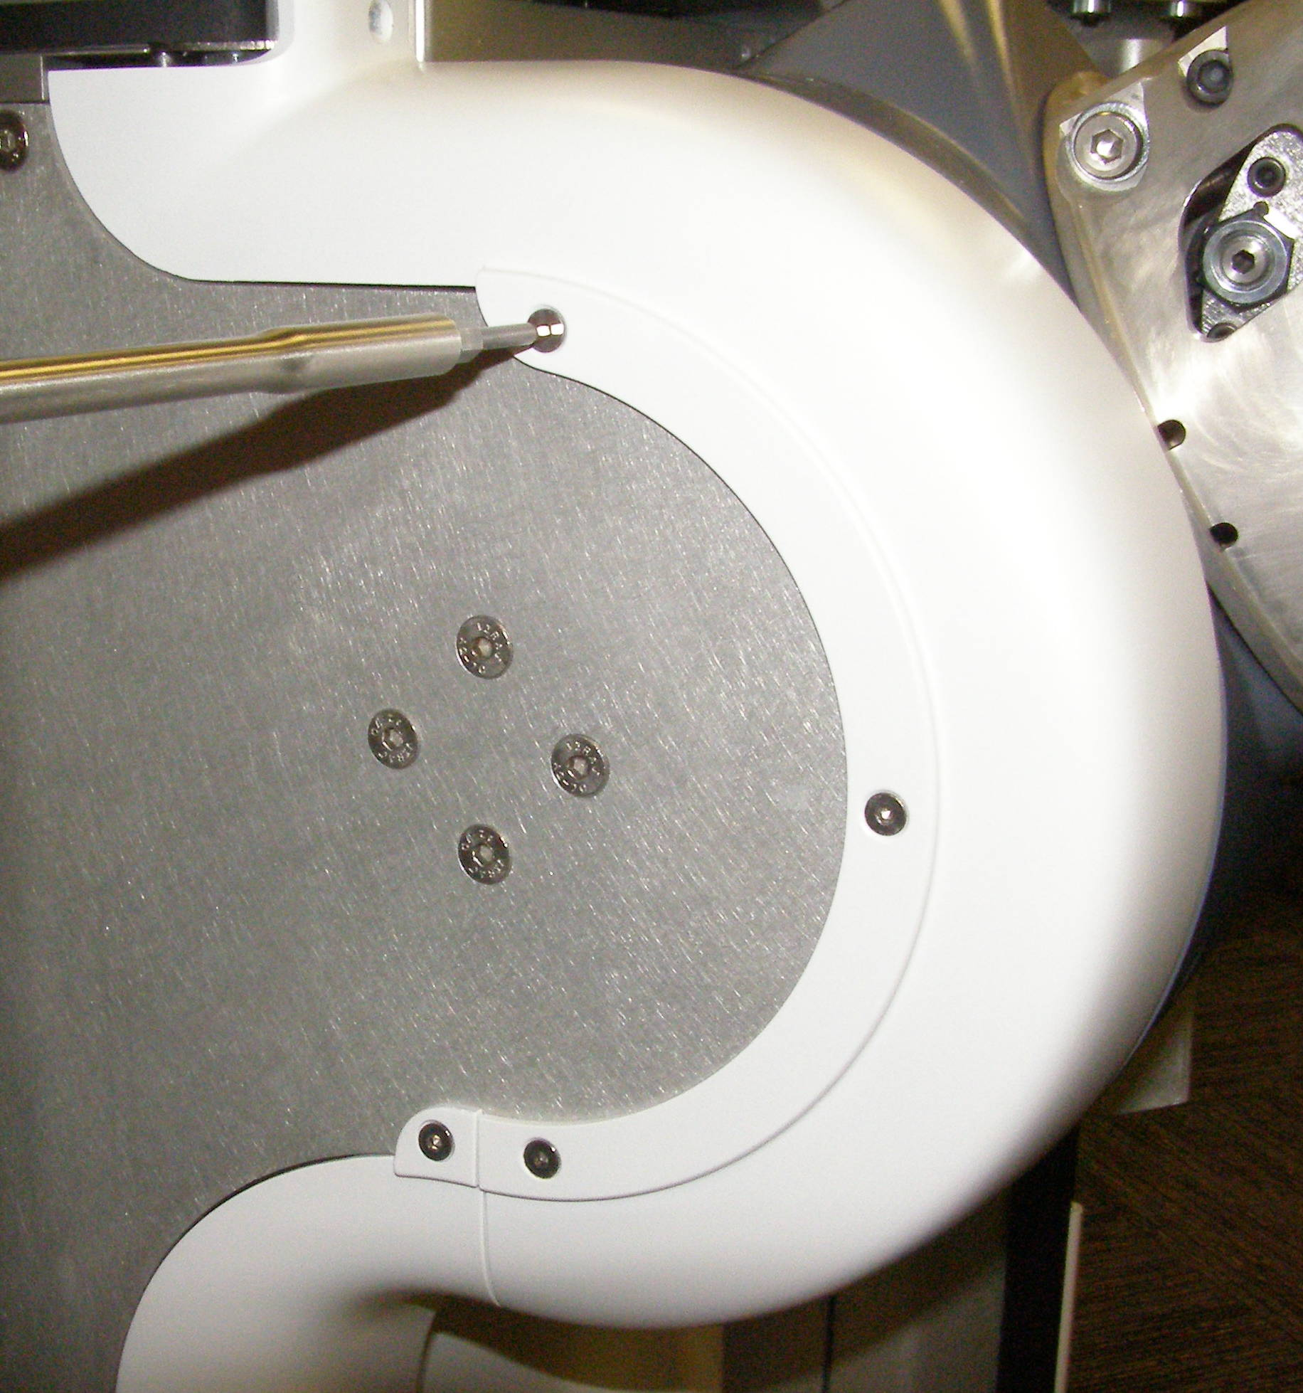
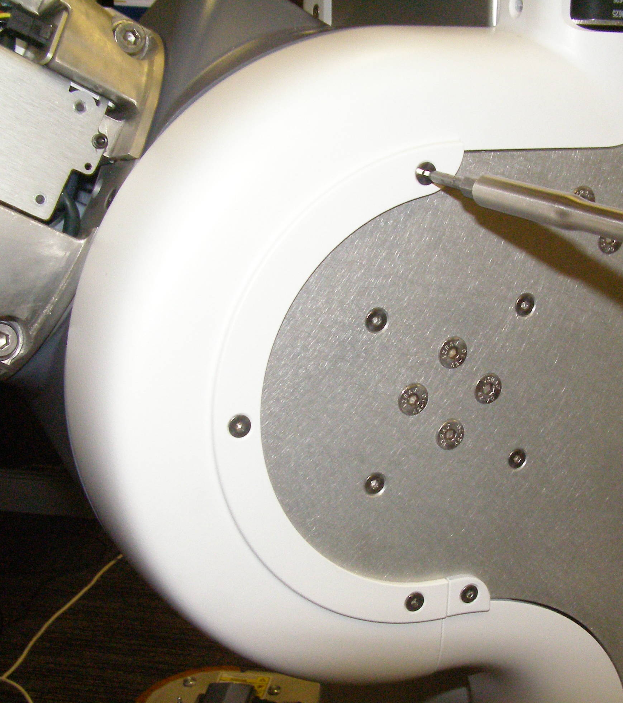

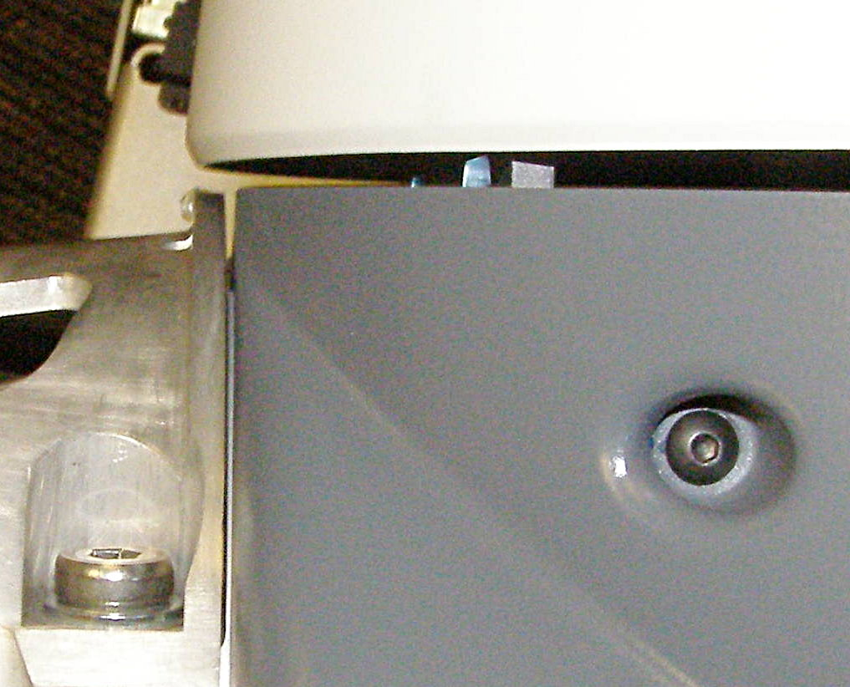

Shoulder Covers R/R (1)
Requires two people to remove covers
Turret Cover Left - 2656 + Right - 2657, Removal
  Using the 2.5mm bit with the T-handle driver, remove 4 Flathead screw for each side. 3064-06 (Fig 1-4)
Turret Cover Left and Right, Install
  Reverse the removal procedure.
  Using Loctite 248, install the 4 screws and torque to 0.80Nm using the Small torque driver.
Shoulder Cover, Removal – 1665
  Rotate the Arm all the way down to expose the screws at the top.
  Using the 2mm bit with the T-handle driver, remove 1 Panhead screw. 2500-06 (Fig 5)
  Using the 1.5mm bit with the T-handle driver, remove 1 Panhead screw. 2019-12 (Fig 6)
Fig 1
Fig 6
Fig 1
Fig 3
  Using the 2.5mm bit with the T-handle driver, remove 3 Panhead screws. 2085-10 (Fig 7)
Shoulder Cover, Install
  Using Loctite 248, and the 2.5mm bit install the 3 Panhead screws and torque to 0.80Nm using the Small torque driver. Bias the cover towards the Robot to insure there is a small gap between it and the Upper Arm. (Fig 7,8)
  Hold the two covers in alignment and together with your hand. Using Loctite 248, combine the 2mm bit with the hex ¼ adapter and the ¼ male to ¼ hex adapter, install the Panhead screw and torque to 0.34Nm using the Small torque driver. (Fig 9)
Fig 2
Fig 4
Fig 7
Fig 8
Fig 5

Slide 3
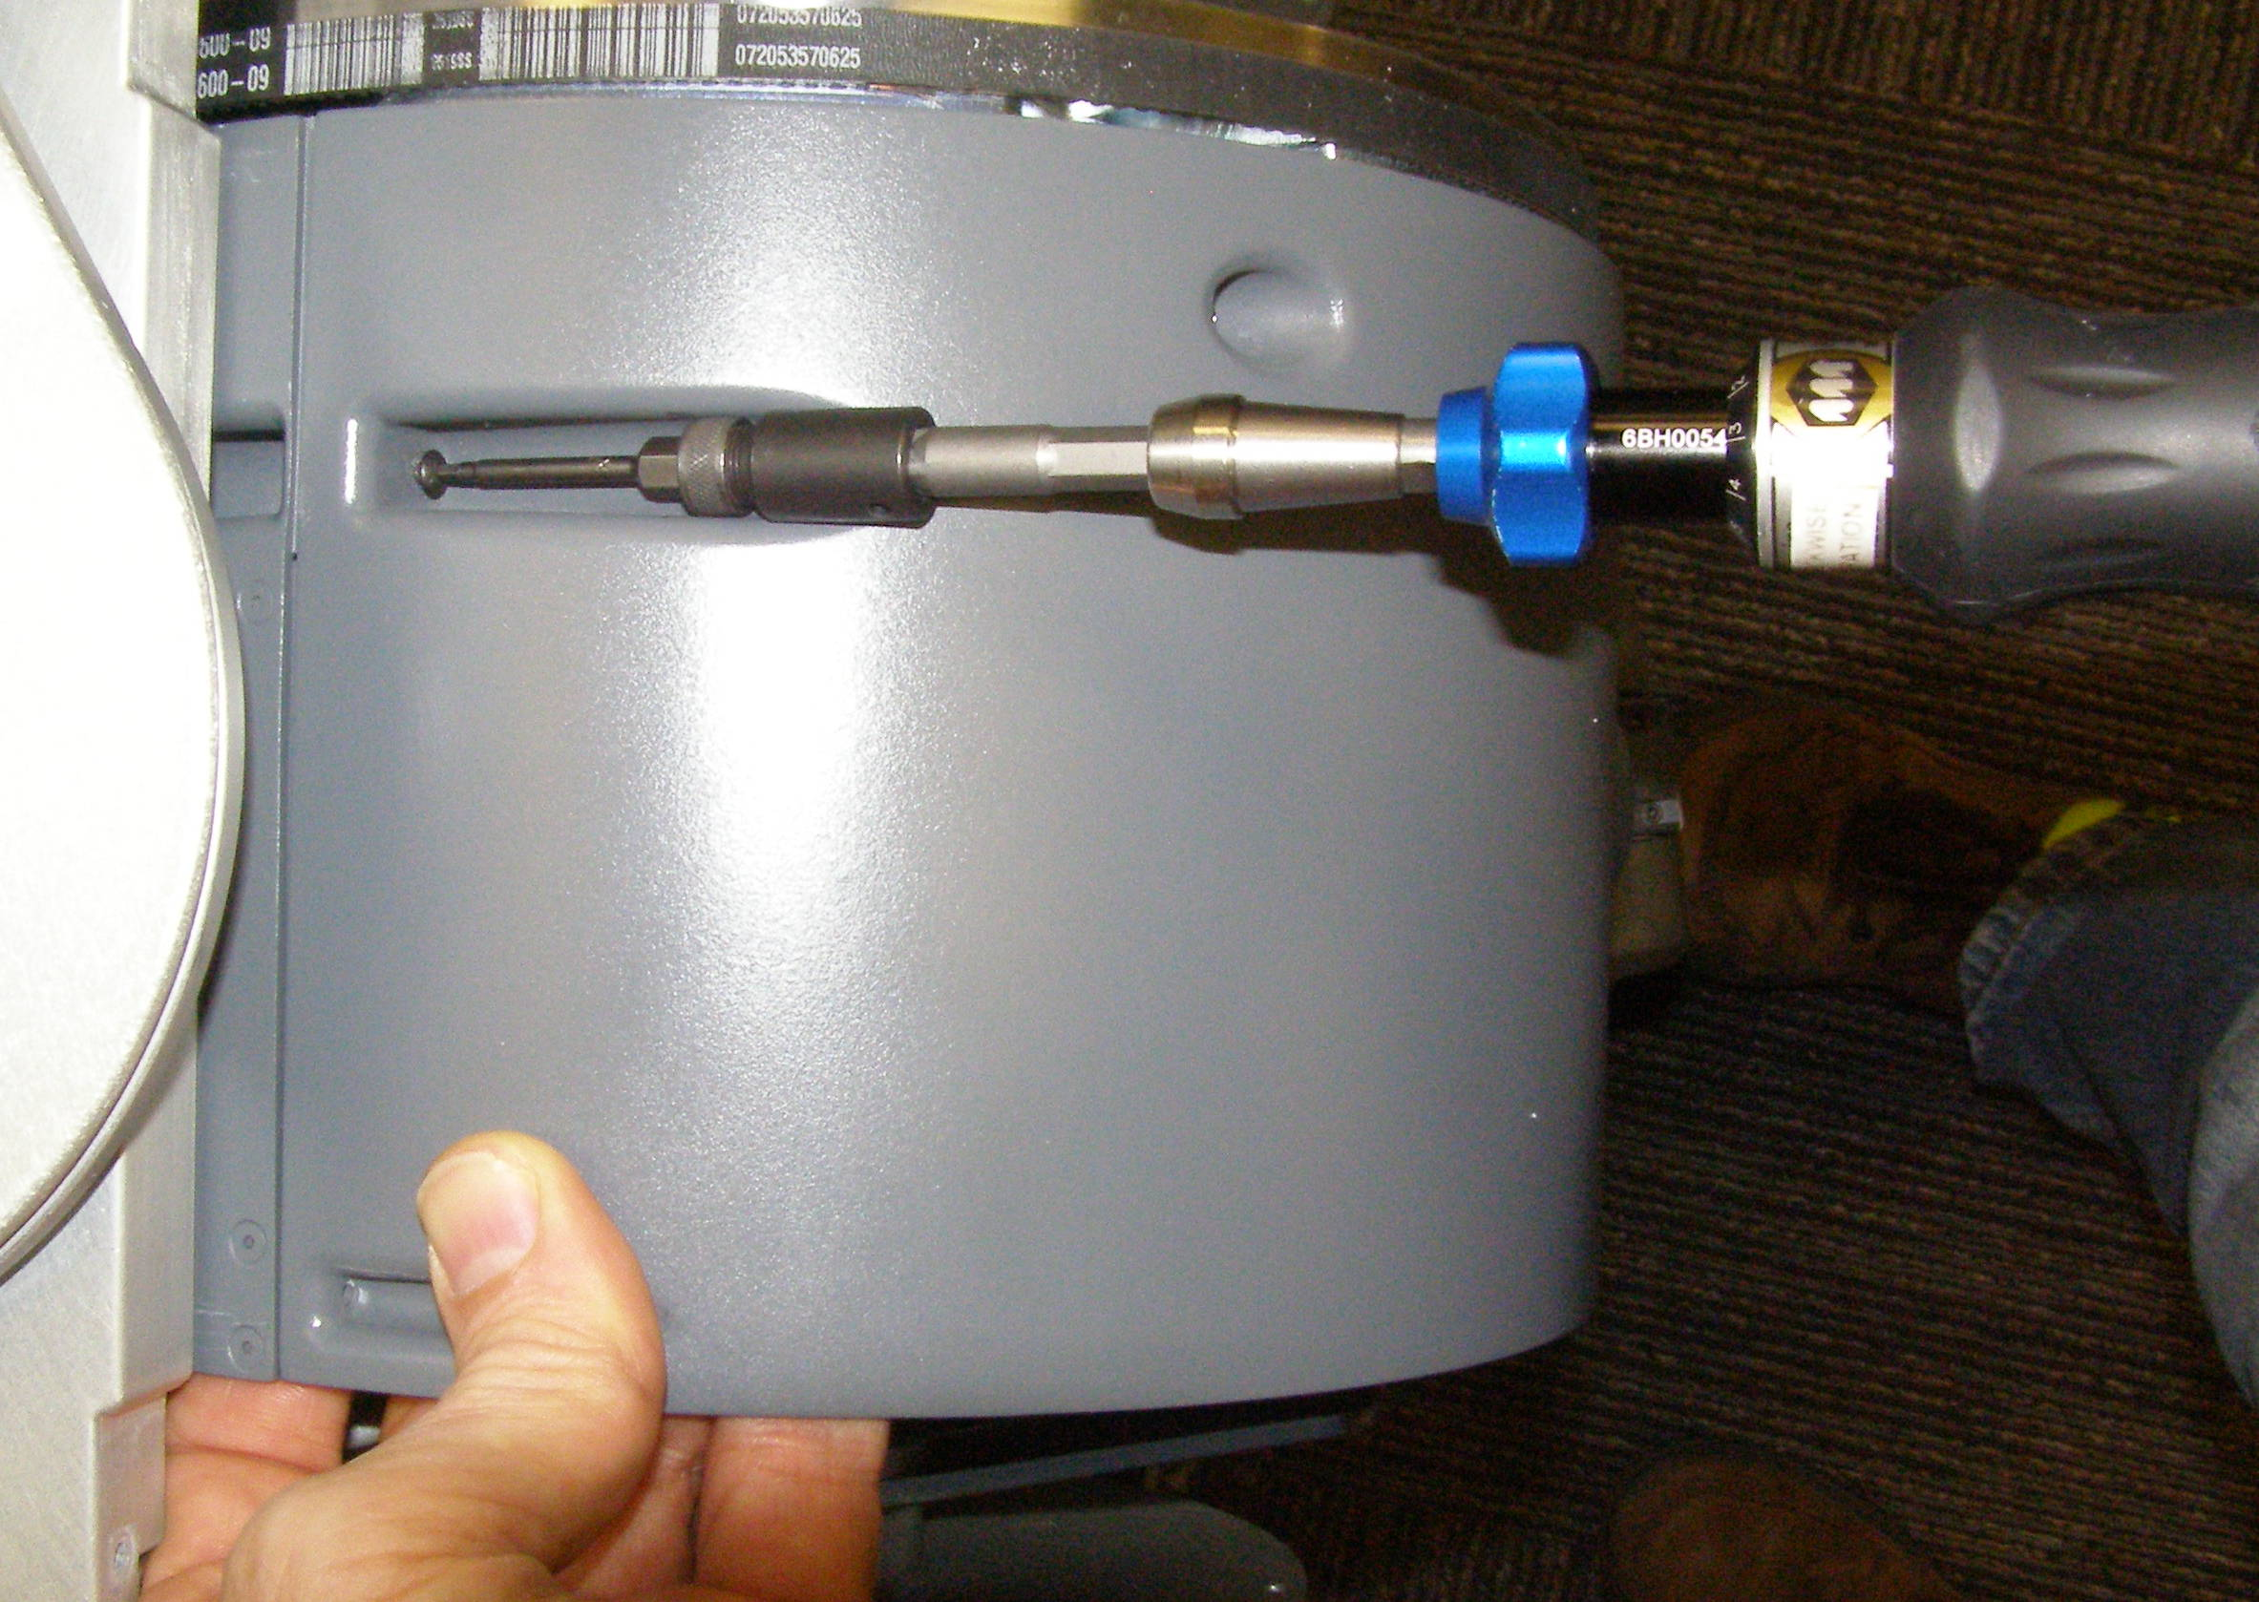
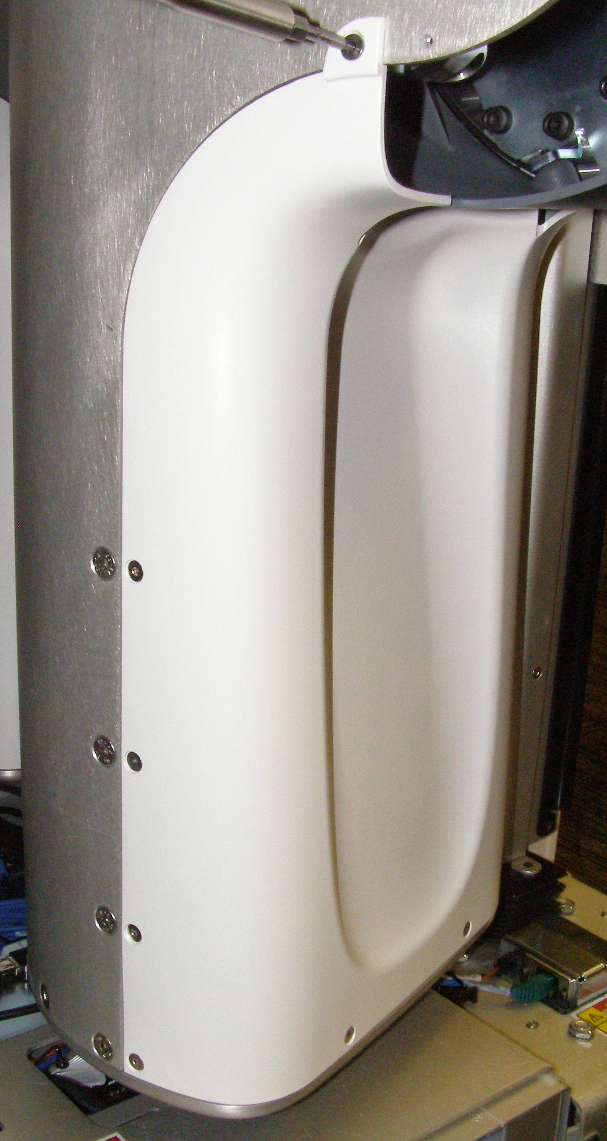
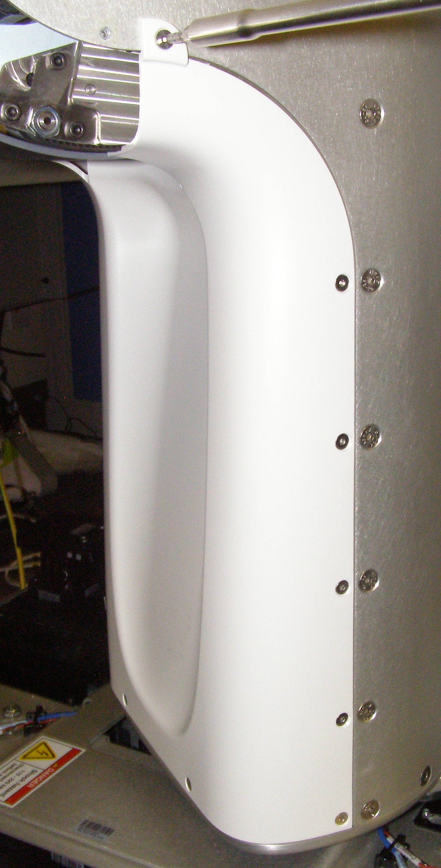
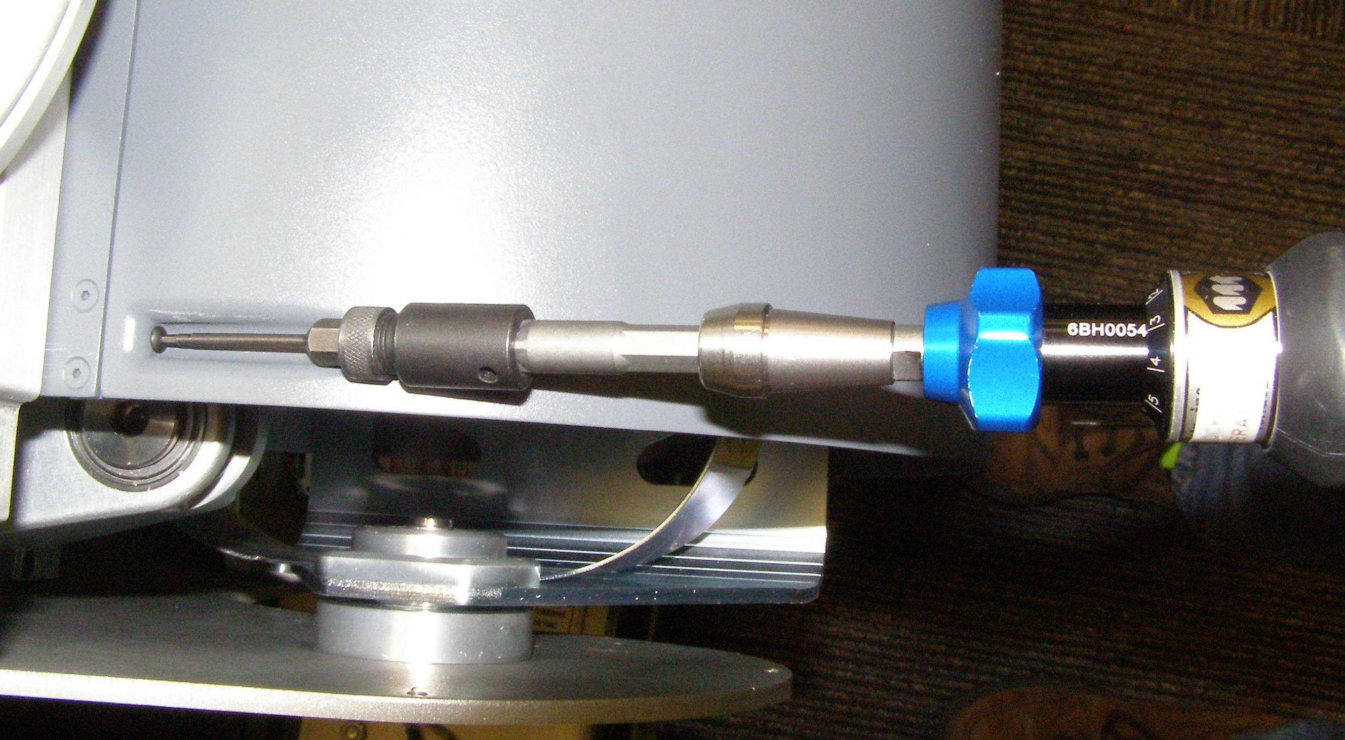
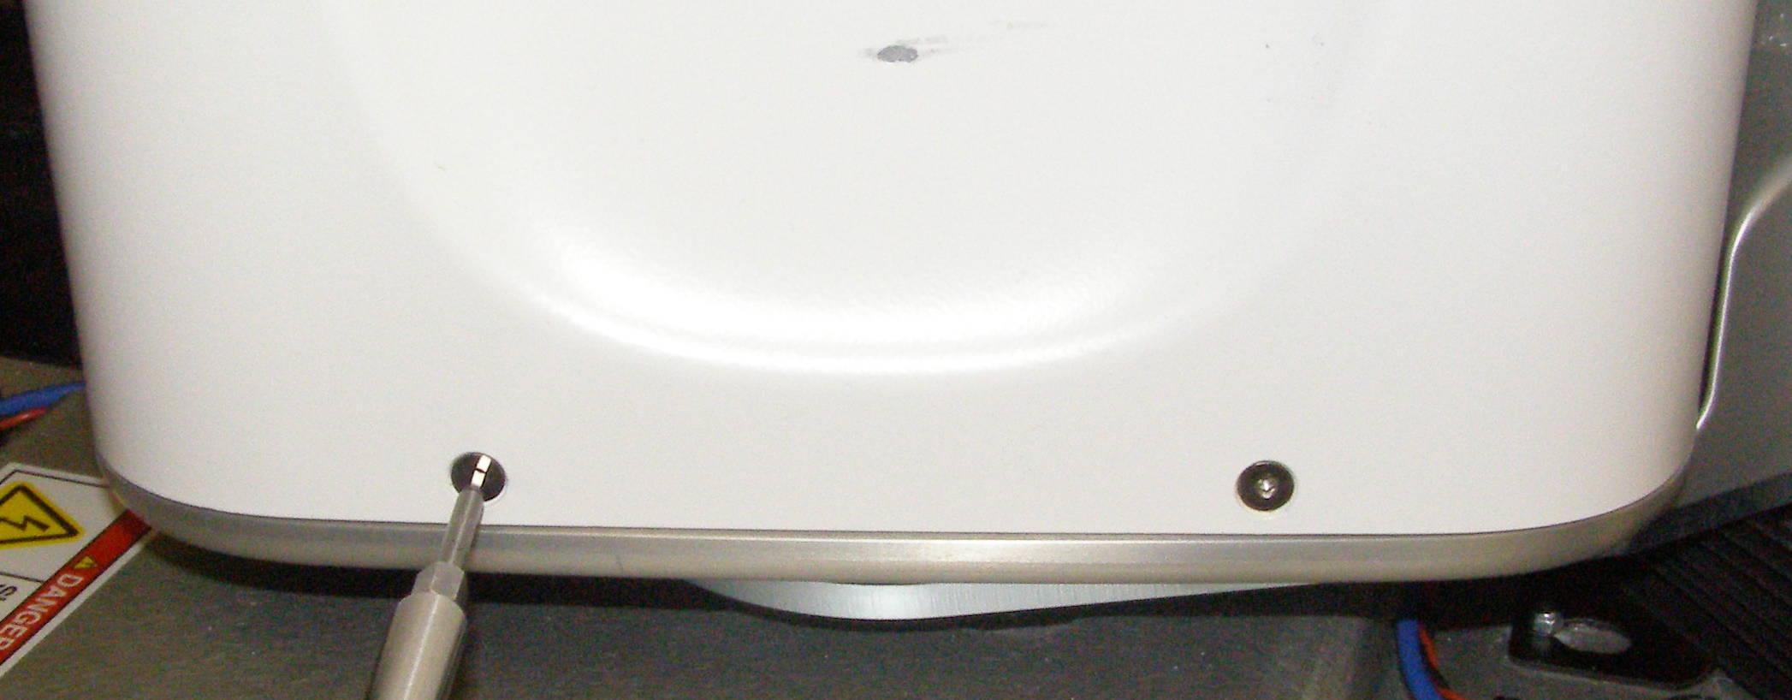

Shoulder Covers R/R (2)
Fig 9
Requires two people
Shoulder Cover Bottom, Install
  Reverse the removal procedure.
  Using Loctite 248, install the 3 screws and torque to 0.68Nm using the Small torque driver.
Turret Cover, Removal – 2655
  First remove the Shoulder Cover and Shoulder Cover Bottom.
  Using the 2.5mm bit with the T-handle driver, remove 13 screws. 3064-06, 3064-12
  (Fig 12,13,14)
Turret Cover, Install
  Reverse the removal procedure.
  Using Loctite 248, install 2 3064-06 screws at the top and the remaining 11 3064-12 screws and torque to 0.80Nm using the Small torque driver.
  Using Loctite 248, combine the 1.5mm bit with the hex ¼ adapter and the ¼ male to ¼ hex adapter, install the screw and torque to 0.34Nm using the Small torque driver. (Fig 10)
Shoulder Cover Bottom, Removal – 2502
  First remove the Shoulder Cover
  Using the 2.5mm bit with the T-handle driver, remove 3 Panhead screw. 2085-10 (Fig 11)
6mm 3064-06
6mm 3064-06
Fig 10
12mm 3064-12
12mm 3064-12
Fig 12
Fig 13
Fig 14
12mm 3064-12
Fig 11

